Slide 1


ARCH-Based Volatility Modeling
Aidan Olson, Arzaan Singh, Leo Small

Slide 2
Agenda
Motivation and Objectives
Data & Exploratory Analysis
ARCH Model
Model Selection and ARCH(M) Results
Volatility Forecasting (Deterministic & Monte-Carlo)
Back testing, Validation, and Library Implementation
Options Pricing
Conclusion & Next Steps

Slide 3
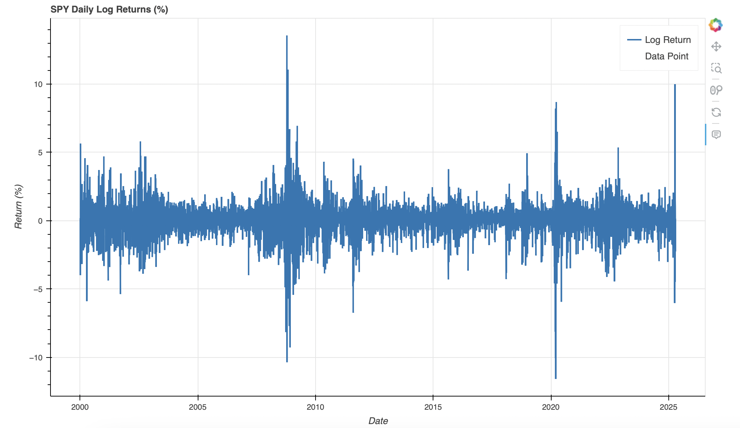
Why Do We need the ARCH model?
Notes:
Ask audience what they see in this graph. Describe it.
Daily returns are wildly erratic, volatility changes a lot.
In most models we take volatility as constant; however, this assumption is wrong.
Volatility clustering
Therefore, we need a model that captures the sudden changes in volatility.
We want to eventually model volatility and use it to price options.
With volatility being one of the most important factors in the price of options.

Slide 4
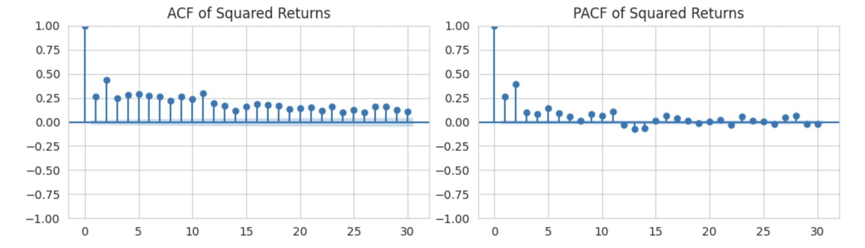
Data & Exploratory Analysis
Loaded in data from yfinance API
Created summary statistics and plots to understand underlying trends/distribution
Analyzed Autocorrelation Function (ACF) and Partial Autocorrelation Function (PACF)
Notes:
First, we loaded in data from Yahoo Finance API
Cleaned the Data and found daily returns.
Created plots and summary statistics on daily returns for SPY, mean, variance, skewness, and more
We then did our first preliminary analysis using ACF and PACF, which essentially measure whether current returns depend on past returns.
The plots clearly suggest that is the case; therefore, volatility must also be dependent on past volatility (show spike and non-zero correlation on graph)

Slide 5
THE Model

Slide 6
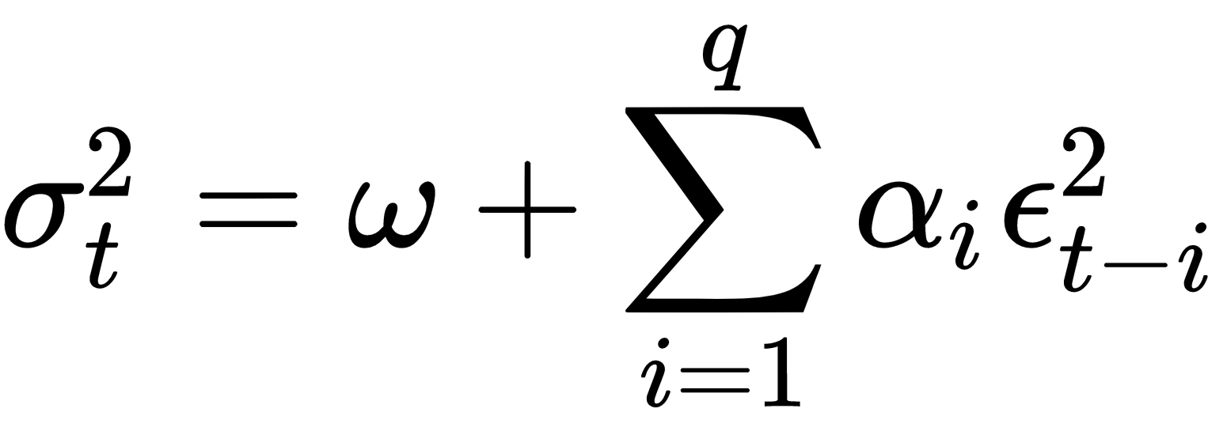
Autoregressive Conditional Heteroskedasticity Model
A model created in 1982 ARCH forecasts how volatility will change over time. ARCH uses the previous a weighted average of previous days’ volatility to predict future volatility
Volatility is a key input in options pricing. However, unlike what we have seen in class, volatility is far from constant. ARCH helps model that variance in volatility by considering past volatility.
In essence, current volatility is conditional on past volatility
Notes:
https://www.oreilly.com/library/view/python-for-finance/9781789618518/1ad96561-4f9d-4839-82fc-9cfdb1205f0f.xhtml

Slide 7
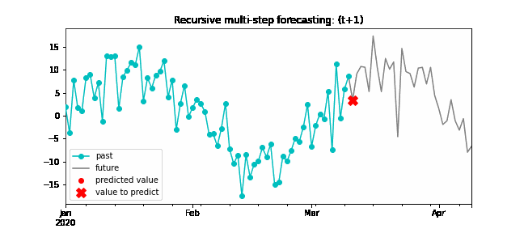
Conditional Autoregression and Volatility Clustering
The first main concept of the ARCH Variance Model
Present data is regressed on previous data which is then used to predict future data
Notes:
Present data is regressed on previous data which is then used to predict future data
The concept Volality clustering is why the ARCH model is so powerful,
It is used by the ARCH model to help predict future levels of volatility
Since it looks at past (squared) errors, the higher the volatility in the current past, the higher the expected volatility in the future

Slide 8
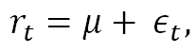
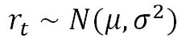
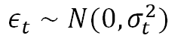
heteroskedasticity
The second main concept of the ARCH Variance Model
Refers to the fact that variance of the return is not constant, changing in response to shocks.
Homoscedastic Return Modeling:
Heteroskedastic Return Modeling:
$$r_{t}∼N(μ,σ^{2})$$
$$r_{t}=μ+ ε_{t},$$
$$ε_{t}∼N(0,σ_{t}^{2})$$
Notes:
While homoscedastic, a big term meaning constant, suggests that returns are sampled simply from a normal distribution with constant volatility
Heteroskedastic models in the change in volatility

Slide 9
MODEL FORMULATION

Slide 10
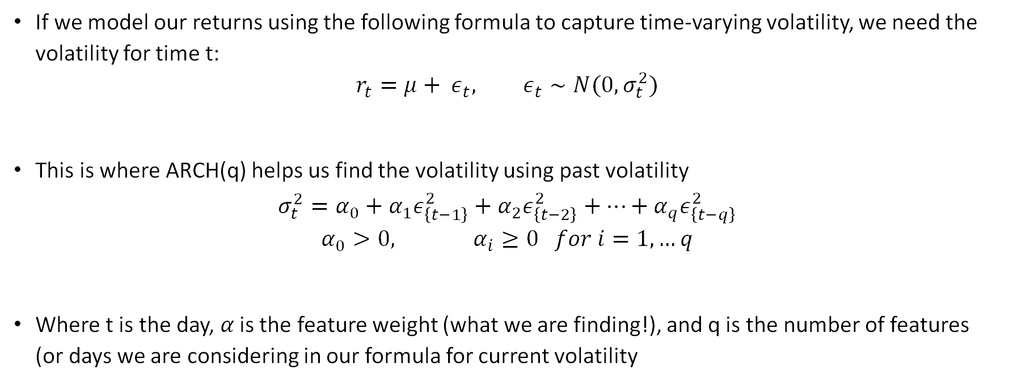
Math
If we model our returns using the following formula to capture time-varying volatility, we need the volatility for time t:
$$r_{t}=μ+ ε_{t}, ε_{t}∼N(0,σ_{t}^{2})$$
This is where ARCH(q) helps us find the volatility using past volatility
$$σ_{t}^{2}=α_{0}+α_{1}ε_{\left\{t−1\right\}}^{2}+α_{2}ε_{\left\{t−2\right\}}^{2}+…+α_{q}ε_{\left\{t−q\right\}}^{2}$$
$$α_{0}>0, α_{i}≥0 for i=1, …q$$
Where t is the day, 𝛼 is the feature weight (what we are finding!), and q is the number of features (or days we are considering in our formula for current volatility
Notes:
Notes:
Line 1)
$μ$ represents the mean return.
Saying “rt​∼N(μ,σ2)” implicitly assumes a constant variance σ2\sigma^2σ2
Lines 2/3)
ARCH(q) predicts variance using variances from the previous q time steps. A common number for q is 10 which provides enough recent context without including terms that are too old.
“Here on the first slide, we set up our ARCH framework by writing the return r_t​ as a constant mean plus a shock, ϵt​, which itself is σt​ times a standard normal innovation zt​. We then specify the conditional variance σt^ as an ARCH(q) process—that is, a baseline variance α0​ plus a weighted sum of the past q squared residuals. The nonnegativity constraints α0>0, αi≥0 guarantee that variance stays positive, and by feeding past large shocks into σt^2, we capture the familiar volatility-clustering effect where big moves tend to follow big moves.”

Slide 11
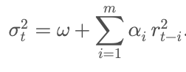
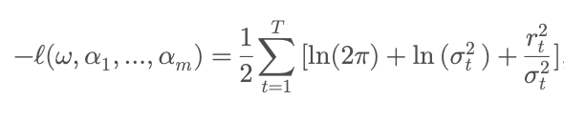
More Math
So, how do we solve for these features (𝛼)?
Gaussian log-likelihood parameter estimation:
We maximize the likelihood of a parameters for our given dataset using gradient descent
We also add a positivity constraint for the parameters to avoid cases like negative variance
Use
Notes:
Notes:
We use the idea of likelihood maximization.
“Moving to the second slide, we first highlight the core intuition—if ϵt−1^2 is large, then today’s variance will also be elevated—and then show how we estimate the α’s by maximizing the Gaussian log-likelihood, summing over terms of the form in the first line. This likelihood is optimized numerically to produce our maximum likelihood estimations and associated standard errors. These constants, alpha, act as weights determining how much influence each of the previous q epsilons have on the estimation of today’s variance notated σ^2.
Finally, for the simplest ARCH(1) case, we derive a one-step-ahead forecast​, giving a direct rule for predicting tomorrow’s volatility from today’s shock.
Pulling this all together, we can now compute the alphas and sigmas sequentially to provide an estimate for todays variance that can then inform us of today’s expected returns.”

Slide 12
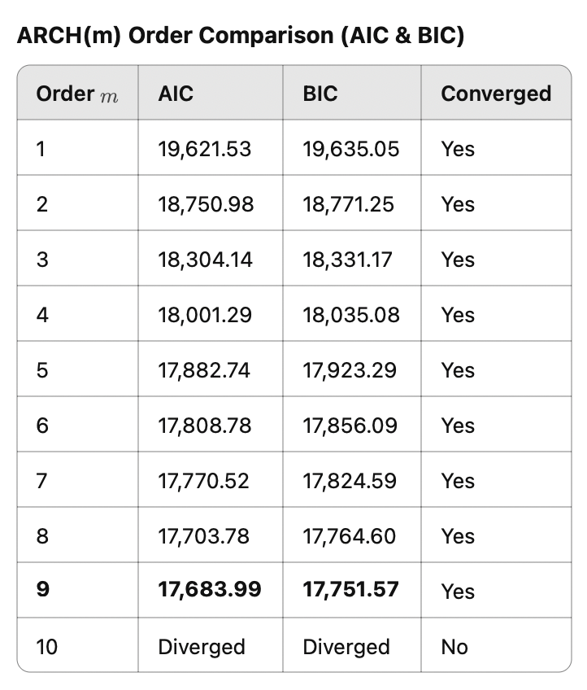
Choosing our ARCH(q) Model
Notes:
We tested the ARCH Model for different values of Q/M and chose the one with the smallest error that did not diverge
This was with Q = 9 days or lags in economics

Slide 13
Results

Slide 14
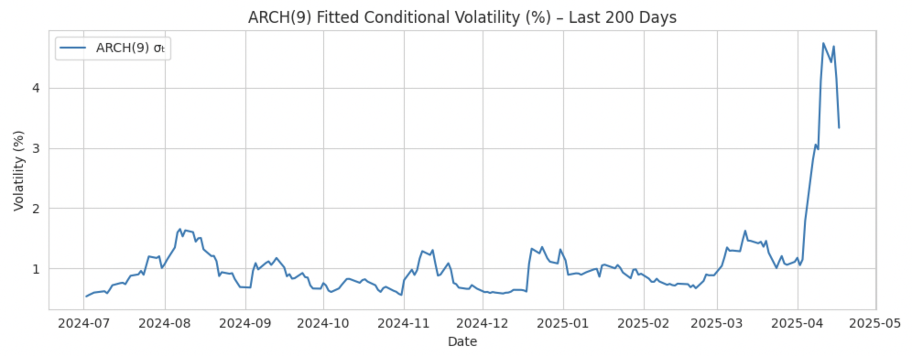
ARCH(9) Fitted Volatility
Notes:
So, now they have our data and model formulated. We can finally use it.
While it would’ve been possible to just import an ARCH library and use it to find volatility, we wanted to understand the model mor intimately.
As well as build something more robust.
So, we first used this model to find conditional volatility for the first 200 days validating it with the library’s plot.
As you can see it does really good predicting the next days volatility and is very similar to actual volatility

Slide 15
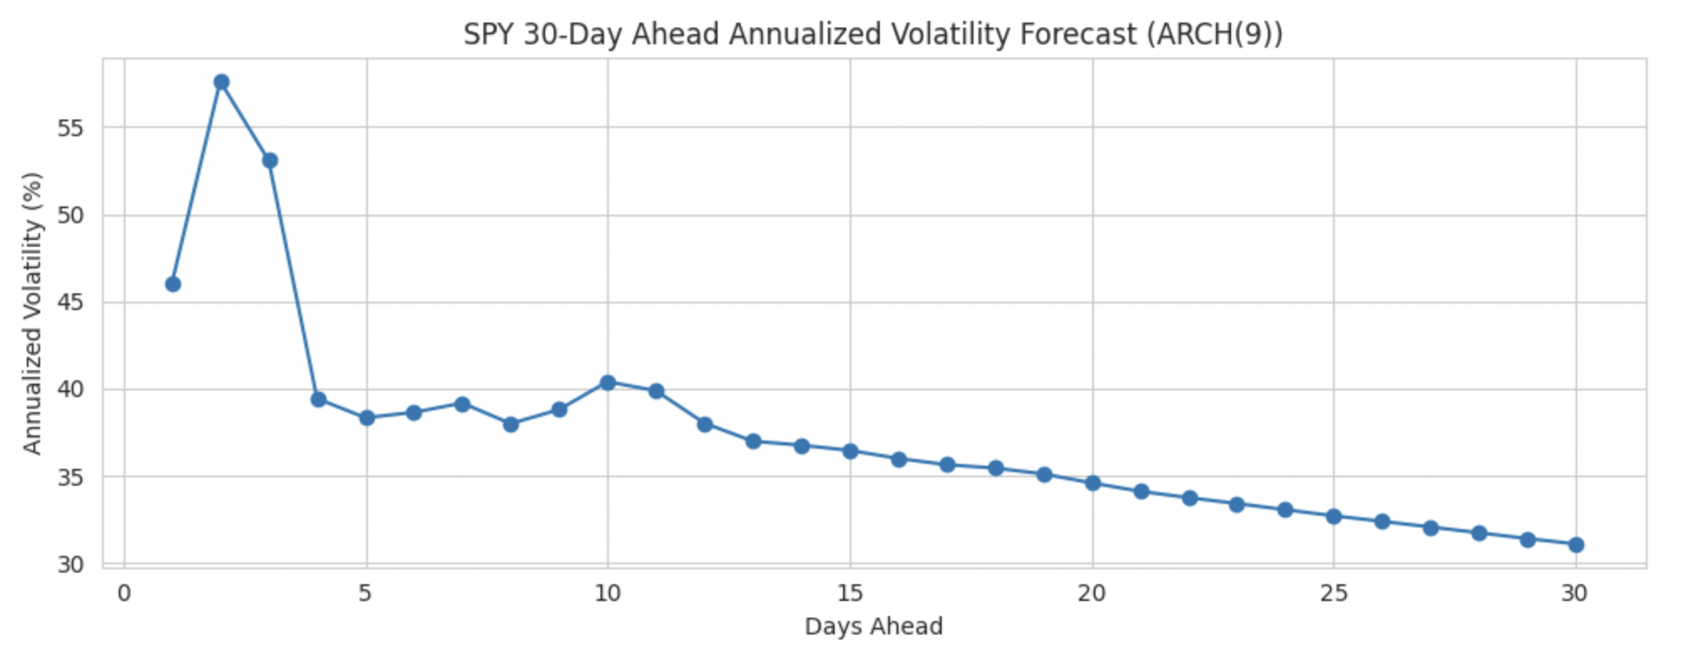
ARCH(9) Future Volatility Prediction
Notes:
Now, it wouldn’t be useful to just check past volatility. So, we used it to find volatility in the future.
Again, it does a great job of taking in to account the recent past’s volatility.
However, you might also notice that forecasting for 30 days means for 21 of the 30 days we are actually using forecasted volatility to predict future volatility.
Therefore, it has this convergent slope that is not as useful and means we really shouldn’t forecast more than the number of lags we consider

Slide 16
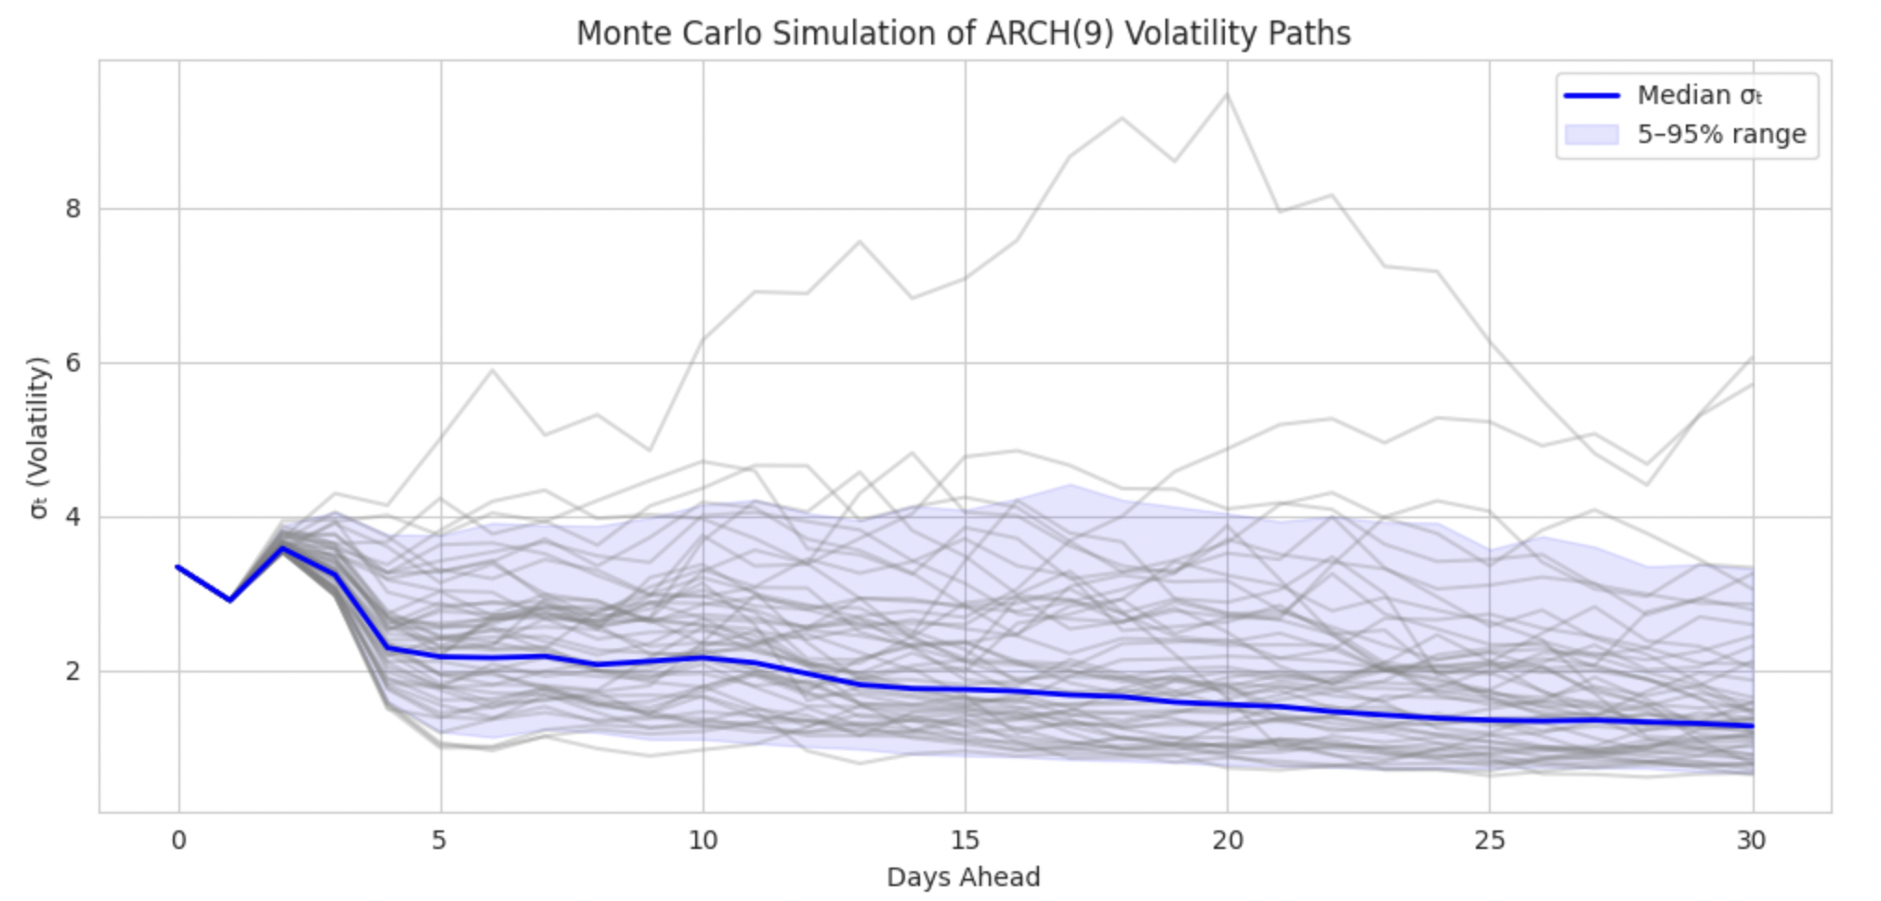
ARCH(9) Volatility with Randomness
Notes:
To build on that, we thought adding some randomness using monte-carlo simulations would more accurately predict what future volatility looks like.
The randomness of course was randomly sampled from normal distrubution, which is why our 90% confidence band looks so similar to before.
However, probalistic forecasting does a much better job of actually capturing the variance in volatility compared to a deterministic forecast.

Slide 17
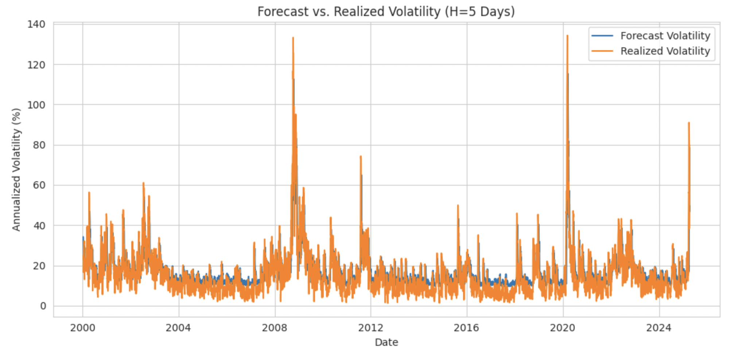
Forecasting Volatility
Notes:
Using all that we learnt, lets use 5 day rolling forecasts to back test our volatility estimates. And, as you can see even though there is a bit of a lag and the forecast is still smoother than actual.
Our forecast does extremely well in actually predicting volatility.

Slide 18
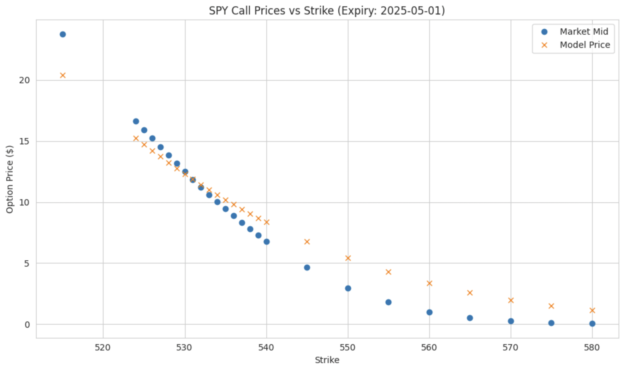
Forecasted vs Actual Options price
Notes:
Finally, we bring it together to price SPY options with a 7-day expiry. While we have the characteristic options curve for call prices versus strike price (exercise price).
Our model does give us some difference. We incorporate higher volatility into the model than what the market implies, and this shows in the higher options price.
However, we also notice that the market has a downside bias. Now the exact reason is difficult to determine, but one of the limitations of ARCH is that it doesn’t take into account black swan events and leverage effects which could be priced into lower exercise price options.

Slide 19
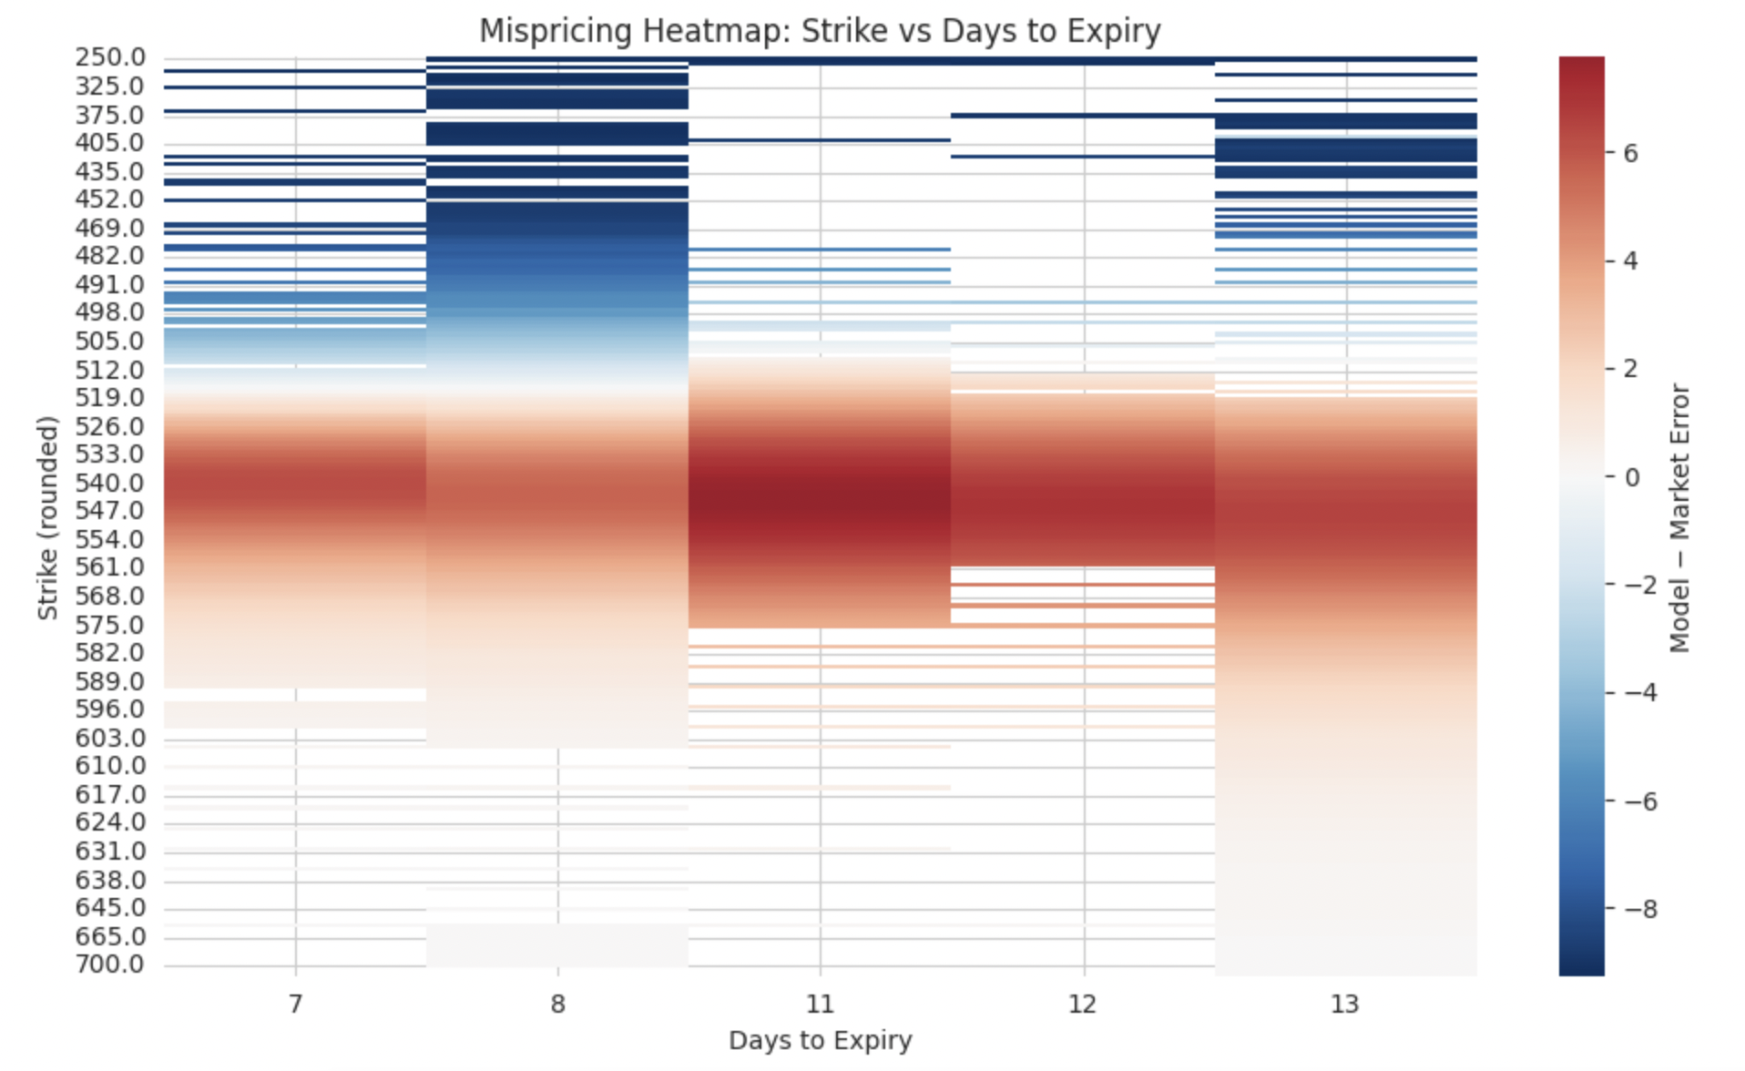
Mispricing

Slide 20
ARCH Model’s Limitations
ARCH treats positive and negative return shocks identically—cannot capture the “leverage effect” (the tendency for volatility to rise more after negative shocks).
While modeling, ARCH looks at past errors and not past variances. This oversight causes it to sometimes miss long-term volatility trends. Standard ARCH assumes Gaussian innovations; it struggles with fat tails unless paired with heavy-tailed error distributions (e.g., Student’s t).
Since ARCH also uses past data, huge sudden swings in the market due to external events can lead to its predictions to be off.
Overfitting vs. Training Error

Slide 21
Further Research
GARCH/EGARCH Model to capture persistence and leverage effects
Add in more representative (fat-tailed distributions) to represent black-swan events in model
Fractal Distributions to simulate volatility clustering and not just a lagged indicator

Slide 22

Thank You

